Slide 1


Which Economic Factors have an impact on the Happiness of a Country?
Musa Bin Salman Makhdoom
1810407
What really is the purpose of economic upliftment?
What do figures such as GDP, inflation, rate of employment etc. really signify?
Are these just numbers on a screen or do they really have an impact on the quality of people’s lives?

Slide 2
Why did I choose this topic?
Growth without joy is useless
Inequality masks real progress
True success is shared success
Stats don’t show suffering
Purpose behind prosperity matters
People > Numbers > Profits

Slide 3
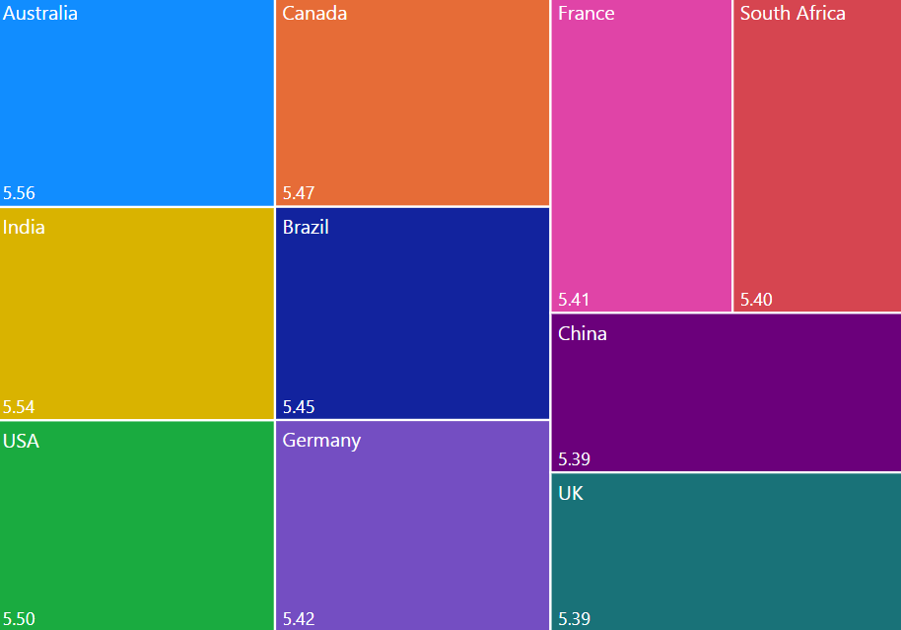
Let's take a look at what the data says
Average of Happiness Score by Country (Heatmap)
‘Happiness is reported to be as high in poor countries as it is in rich countries (Easterlin), no less among paralyzed accident victims than it is among lottery winners (Brickman) and unrelated to stable living conditions (Inglehart and Rabier). These sensational claims are inspected but found to be untrue’ (Veenhoven, 1991).

Slide 4
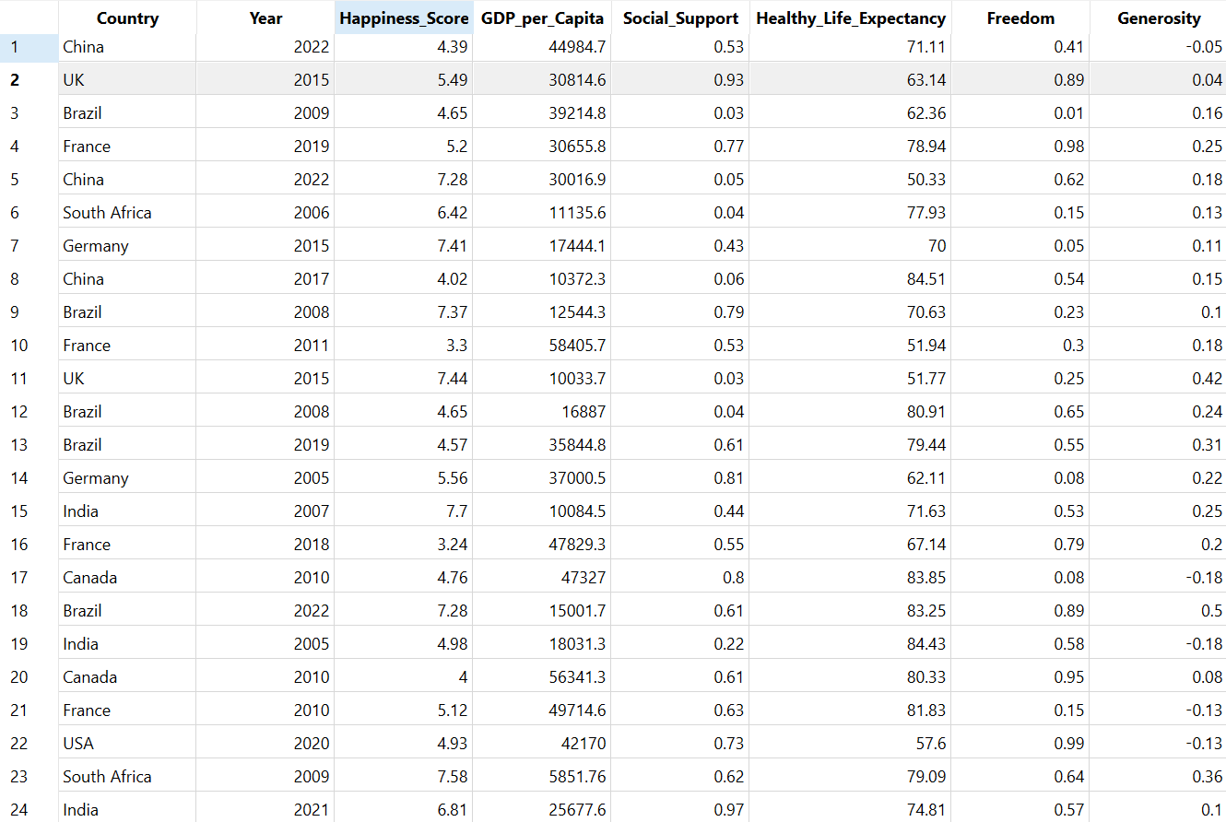
What does the Data look like?

Slide 5
What does the Data consist of?
OBJECTIVES
Happiness Scores by Country
Key Economic Factors by Country
Key Social Factors by Country
Other Important Features
Includes (but not limited to):
Includes (but not limited to):
Includes (but not limited to):
Over 4000 instances
10 countries
Over 10 years of Data
GDP per Capita
Inflation
Unemployment
Freedom
Generosity
Corruption Perception
Population
Urbanization Rate
Climate Index

Slide 6
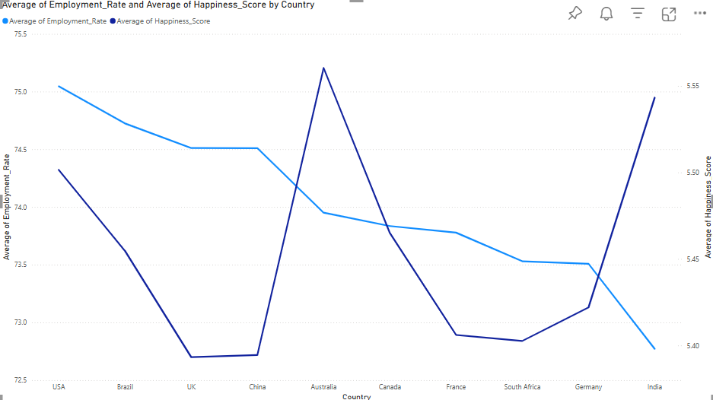
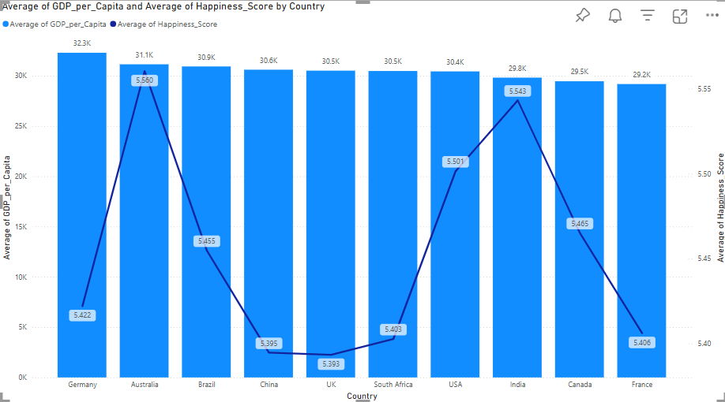
00M
A Deeper Dive into what the Data has to say about the correlation of some Key Economic Factors and the Happiness Scores of a Country
Reveals a consistent upward trend in happiness with increased employment rates, reinforcing the idea that economic inclusion boosts well-being.
Shows that countries in the highest happiness bracket also have significantly higher average GDP per capita
Shows that countries in the highest happiness bracket also have significantly higher average GDP per capita

Slide 7
Steps taken to achieve the Ultimate Goal
DATA COLLECTION
WHICH AIMS TO EVENTUALLY UPLIFT THE QUALITY OF PEOPLE’S LIVES
PRE PROCESSING
ASSISTANCE IN CREATING A BETTER ECONOMIC POLICY
EXPLORATION (VISUALIZATION)
PREDICTIVE ANALYTICS MODELS
PREDICTION OF HAPPINESS SCORES IN RELATION TO KEY ECONOMIC FACTORS

Slide 8
What Descriptive & Predictive Models were used to identify & explore the correlations between KEY Economic Factors and the Happiness Scores by Country?
Visualizations
Generated to identify the impact of certain economic factors on the happiness scores of a country
Linear Regression
Applied to quantify the strength & direction of the relationship between certain economic indicators and national happiness scores ‘OpenAI2025, ChatGPT[Large language model], OpenAI, viewed 3 May 2025’ http//chat.openai.com/chat>
Random Forest
Applied to identify which economic variables have the strongest impact on the happiness scores ‘OpenAI2025, ChatGPT[Large language model], OpenAI, viewed 3 May 2025’ http//chat.openai.com/chat>

Slide 9
Why use Linear Regression?
Quantifying Relationships
Allows us to measure how much each economic factor—like GDP, inflation, or employment—directly affects national happiness scores ‘OpenAI2025, ChatGPT[Large language model], OpenAI, viewed 3 May 2025’ http//chat.openai.com/chat>
Predicting Happiness
It will help us forecast future happiness levels based on economic changes ‘OpenAI2025, ChatGPT[Large language model], OpenAI, viewed 3 May 2025’ http//chat.openai.com/chat>
Simplicity & Interpretability
Linear regression offers a transparent, easy-to-understand model, making insights accessible for policy and decision-makers ‘OpenAI2025, ChatGPT[Large language model], OpenAI, viewed 3 May 2025’ http//chat.openai.com/chat>

Slide 10
Why use Random Forest?
Identifying Key Drivers
Random Forest ranks the importance of each economic variable, helping us pinpoint which factors most influence happiness ‘OpenAI2025, ChatGPT[Large language model], OpenAI, viewed 3 May 2025’ http//chat.openai.com/chat>
Handling Complexity
It captures complex, non-linear relationships between economic indicators and happiness that simpler models might miss ‘OpenAI2025, ChatGPT[Large language model], OpenAI, viewed 3 May 2025’ http//chat.openai.com/chat>
Improving Predictive Power
By combining multiple decision trees, Random Forest enhances prediction accuracy and reduces the risk of overfitting ‘OpenAI2025, ChatGPT[Large language model], OpenAI, viewed 3 May 2025’ http//chat.openai.com/chat>

Slide 11
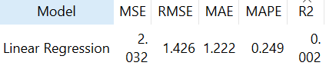
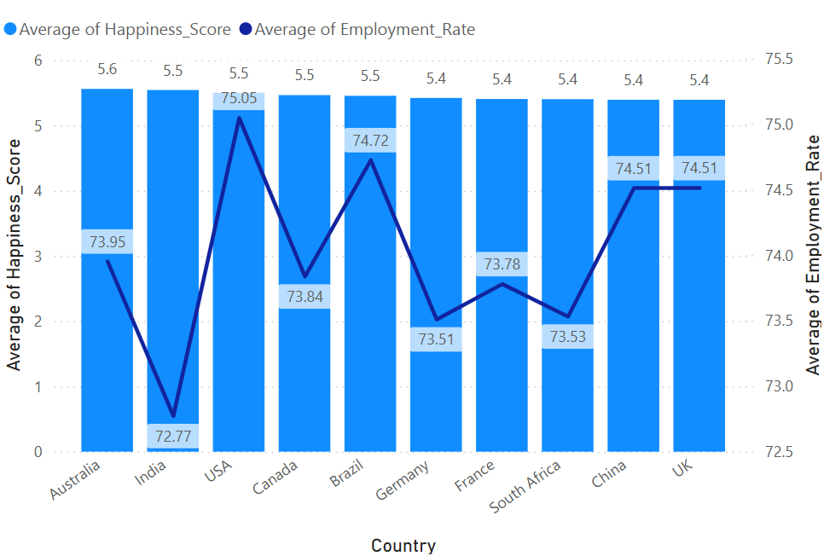
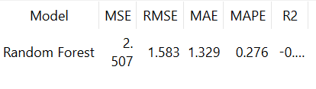
Initial Results
LINEAR REGRESSION WITH GDP AND EMPLOYMENT RATE AS FEATURES TO PREDICT HAPPINESS SCORES
Shows NO clear relationship between either GDP or Employment rate with the happiness scores as per the R2 value which is negative.
RANDOM FOREST WITH GDP AND EMPLOYMENT RATE AS FEATURES TO PREDICT HAPPINESS SCORES
Shows NO clear relationship between either GDP or Employment rate with the happiness scores as per the R2 value which is negative

Slide 12
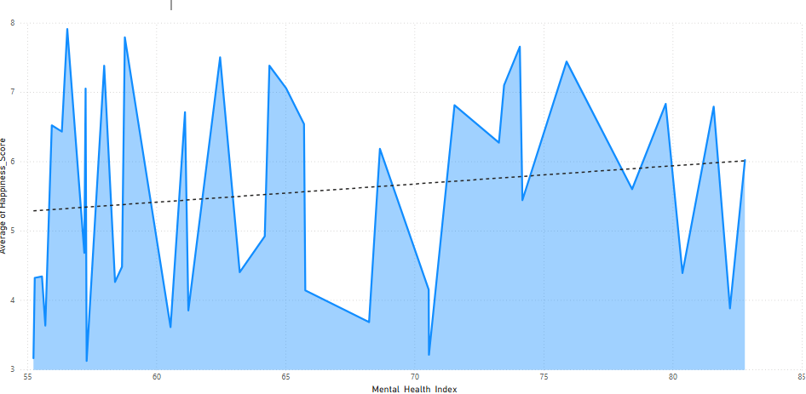
Initial Results
This Area chart shows the average of Happiness Score against Mental Health Index (Score)
Although the relationship does not seem linear in nature, the trend line clearly shows that with increasing mental health index, the happiness scores tend to increase over time
However, the same cannot be said about the relationship between happiness scores and various economic indicators uptil now

Slide 13
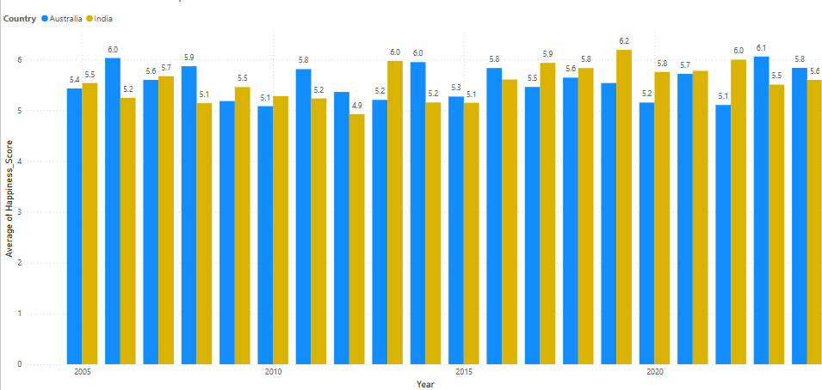
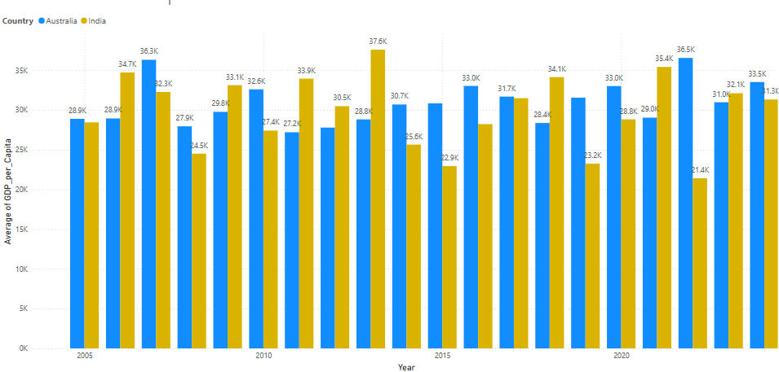
Initial Results (Comparisons)
Comparison of Happiness Scores Australia vs India
Comparison of GDP per Capita Australia vs India

Slide 14

‘None of us is as smart as all of us’
Through peer review & feedback, I realized that exploring nonlinear models, clustering countries, and refining indicators could help uncover hidden insights.

Slide 15
What’s Next?
CLUSTER ANALYSES
Apply models like Gradient Boosting to detect complex patterns and categorise countries based on indicators and happiness scores
EXPLORE COMPLEX INTERACTIONS
Use models and visuals such as pair plots or correlation heatmaps to uncover hidden relationships
ADDITIONAL DATASETS
Segment countries by income level, region and development status and use more data to increase accuracy
REFINE THE DATA
Reassess and clean economic & social indicators for accuracy and relevance
01
02
03
04

Slide 16
Thank you
“The ultimate purpose of economics is to understand and promote the enhancement of well-being.”
– Ben Bernanke

Slide 17
References
Pryor, F. (2009). Happiness and Economic Systems. Comparative Economic Studies, 51(3), pp.367–383. doi:https://doi.org/10.1057/ces.2009.5.
Lee, Y.M. and Goh, K. (2023). The Happiness-Economic Well-Being Nexus: New Insights From Global Panel Data. SAGE Open, 13(4). doi:https://doi.org/10.1177/21582440231199659.
Lee, Y.M. and Goh, K. (2023). The Happiness-Economic Well-Being Nexus: New Insights From Global Panel Data. SAGE Open, 13(4). doi:https://doi.org/10.1177/21582440231199659.
Veenhoven, R. (1991). Is happiness relative? Social Indicators Research, [online] 24(1), pp.1–34. doi:https://doi.org/10.1007/bf00292648.
Veenhoven, R. (1991). Is happiness relative? Social Indicators Research, [online] 24(1), pp.1–34. doi:https://doi.org/10.1007/bf00292648.
Schonlau, M. and Zou, R.Y. (2020). The random forest algorithm for statistical learning. The Stata Journal: Promoting Communications on Statistics and Stata, [online] 20(1), pp.3–29. doi:https://doi.org/10.1177/1536867x20909688.
Misra, S. and Li, H. (2017). Random Forest - an Overview | ScienceDirect Topics. [online] Sciencedirect.com. Available at: https://www.sciencedirect.com/topics/engineering/random-forest.
Xu, D., Xu, X., Forde, M.C. and Caballero, A. (2023). Concrete and steel bridge Structural Health Monitoring—Insight into choices for machine learning applications. Construction and Building Materials, [online] 402, p.132596. doi:https://doi.org/10.1016/j.conbuildmat.2023.132596.
Biau, G. and Fr, G. (2012). Analysis of a Random Forests Model. Journal of Machine Learning Research, [online] 13(1063-1095), pp.1063–1095. Available at: https://www.jmlr.org/papers/volume13/biau12a/biau12a.pdf.
‌
‌
‌
‌
‌
‌
‌
‌
‌

Slide 18
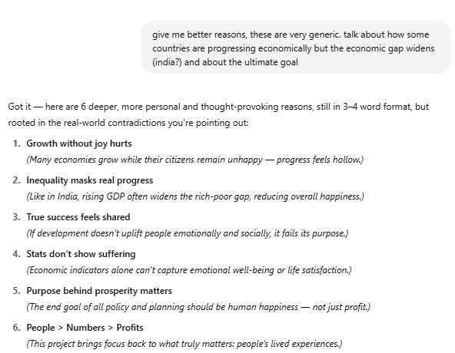
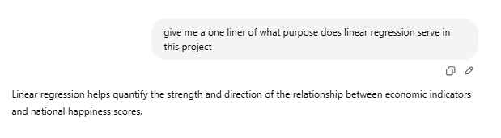
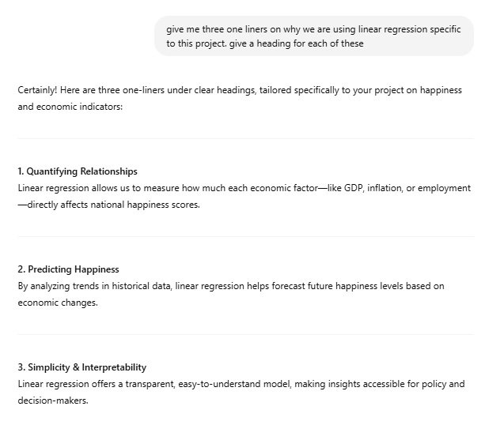
References

